Slide 1
Data Science and Analytics for Managers DS Chapter 3: Predictive Modeling The Math

Slide 2
The Goal: A Decision
We want to make a decision. More than that, we want to make a good decision based on data.
Without any data we have maximum uncertainty. The book calls this entropy.
We reduce uncertainty (decrease entropy) by collecting data.

Slide 3
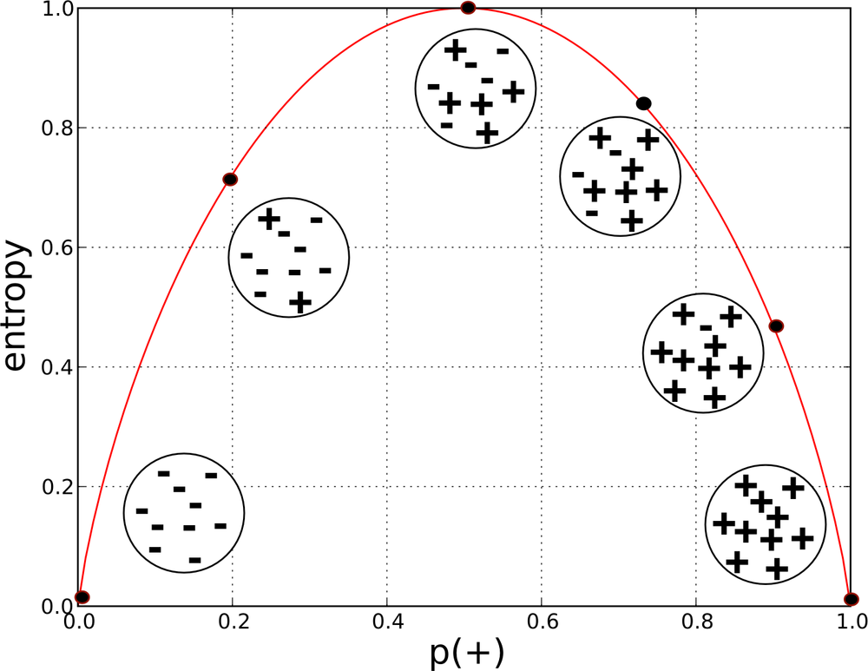
Entropy
Say we have two kinds of things, “-” and “+”.
We collect data that allows us to classify the + and the – into sets.
We have minimum entropy if the data perfectly sorts the + and the -.
We have maximum entropy if the data doesn’t sort the + and the – at all.

Slide 4
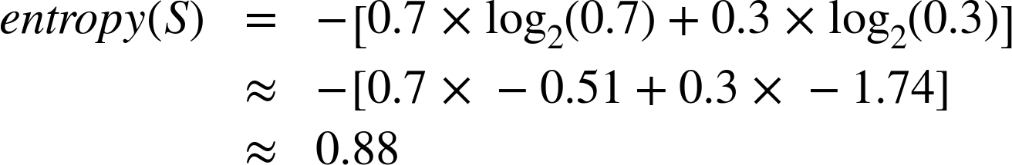
Probabilities
entropy = - p₁ log(p₁) – p₂ log(p₂) - …
We want to classify people into write-off or non-write-off.
We collect data and do the analysis for finding write-offs. We think we have a model, and for 10 predicted write-offs we end up with
7 non-write-offs
3 write-offs
Our entropy (or uncertainty) is 0.88.
The data we collected is not very good at reducing entropy. We need to collect more (or better) data.

Slide 5
Better Data?
We want to collect better data. That is, data that gives us the most information about the target variable.
This means we need to measure how informative an attribute is with respect to the target.
For that, we want to measure the information gain (IG) for each attribute.

Slide 6
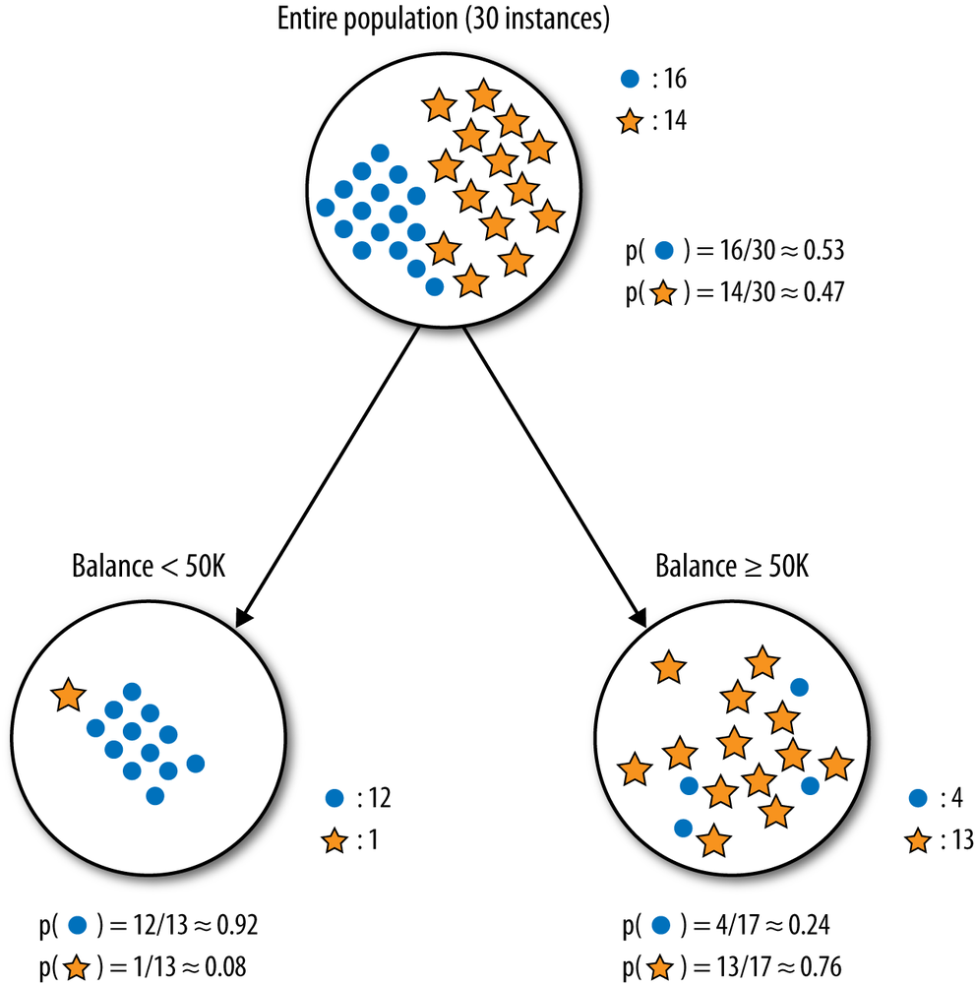
Entropy Reduction
We collect data on Balance. We make a split write-off / non-write-off based on balance < 50k or > 50k
Entropy of the P = 0.99
Entropy of <50k = 0.39
Entropy of >50k = 0.79
Entropy of the pair is 0.62. The information gain is
0.99 – 0.62 = 0.37
In other words, our uncertainty has gone from 0.99 to 0.62. It’s not perfect, but we’re much less uncertain about write-offs

Slide 7
Pause for a moment…
Now, go to the book and read the mushroom example starting on Page 56.
Don’t get bogged down in the math, but watch how additional data reduces uncertainty in the mushroom classification problem.
I’ll go through the figures and tell you what they mean.

Slide 8
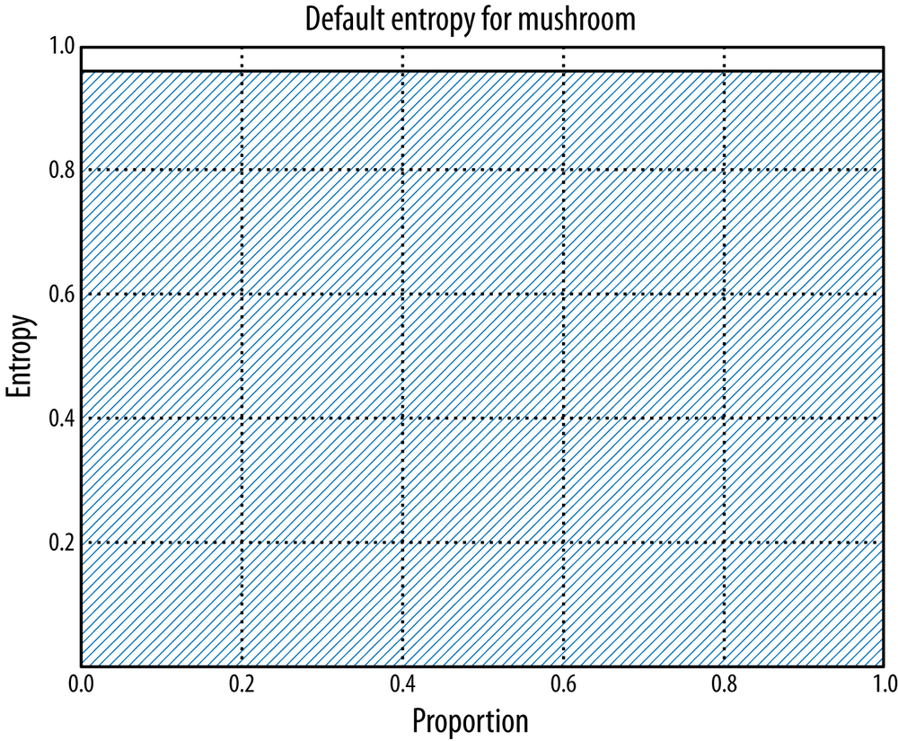

Slide 9
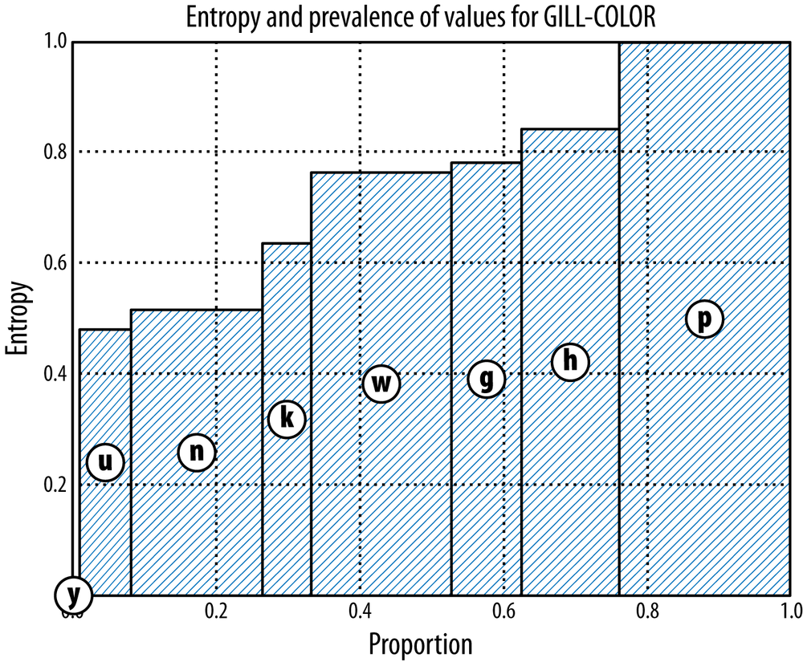

Slide 10
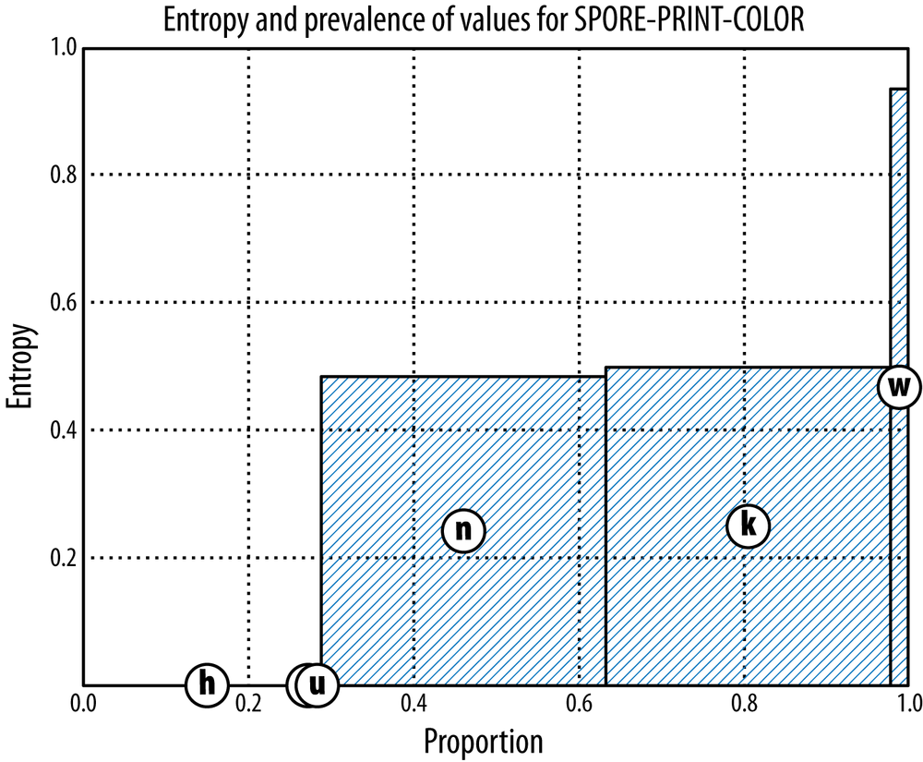

Slide 11
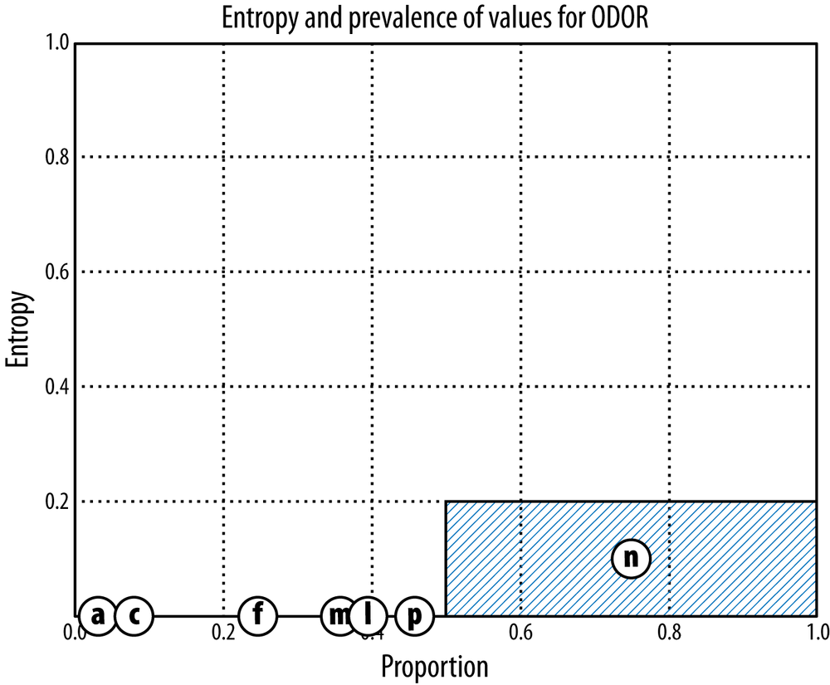

Slide 12
So what?
Collecting data costs time and money. The more data you have the more it costs to maintain, so you want to be very careful about your data collection.
In the mushroom example, ODOR has the highest information gain of any attribute in the Mushroom dataset. It reduces dataset’s total entropy to about 0.1 giving it an information gain of 0.96 – 0.1 = 0.86.
Odor is a very informative attribute to check when considering mushroom edibility. If you’re going to build a model to determine the mushroom edibility using only a single feature, you should choose its odor.
On the other hand, if you pick wrong you’re dead. While odor reduces uncertainty to 0.10, are you willing to risk your life on 90% certainty? Perhaps you want to collect more data.

Slide 13
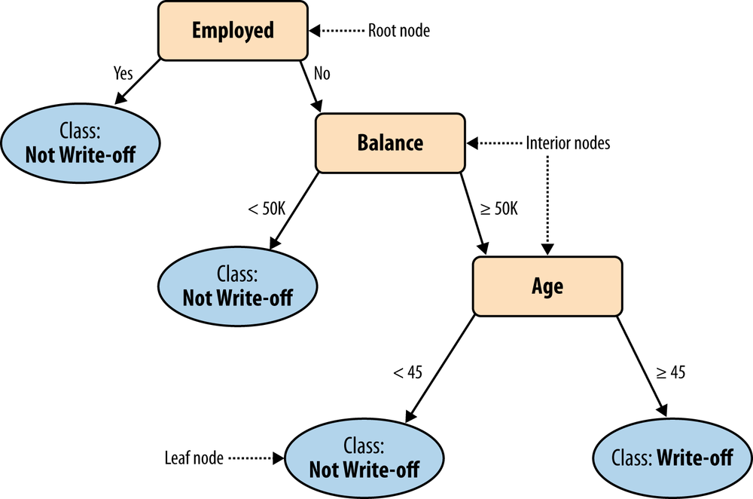
Classification Trees

Slide 14
A Classification Tree
categorical
categorical
continuous
class
Test
Set
Learn
Classifier
Training
Set
Model

Slide 15
Classification Tree
categorical
categorical
continuous
class
Splitting Attributes
Refund
Yes
No
NO
MarSt
Single, Divorced
Married
TaxInc
NO
< 80K
> 80K
NO
YES
Training Data
Model: Classification Tree

Slide 16
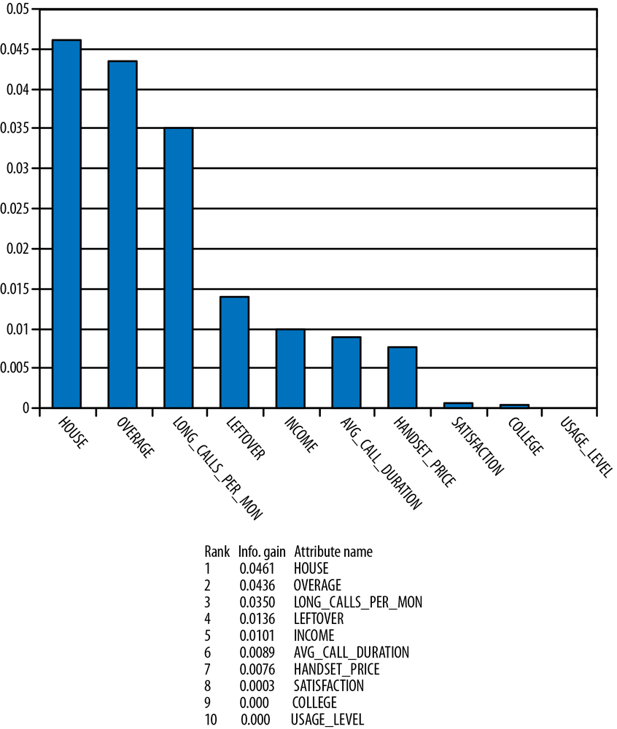
A More Complex Example

Slide 17
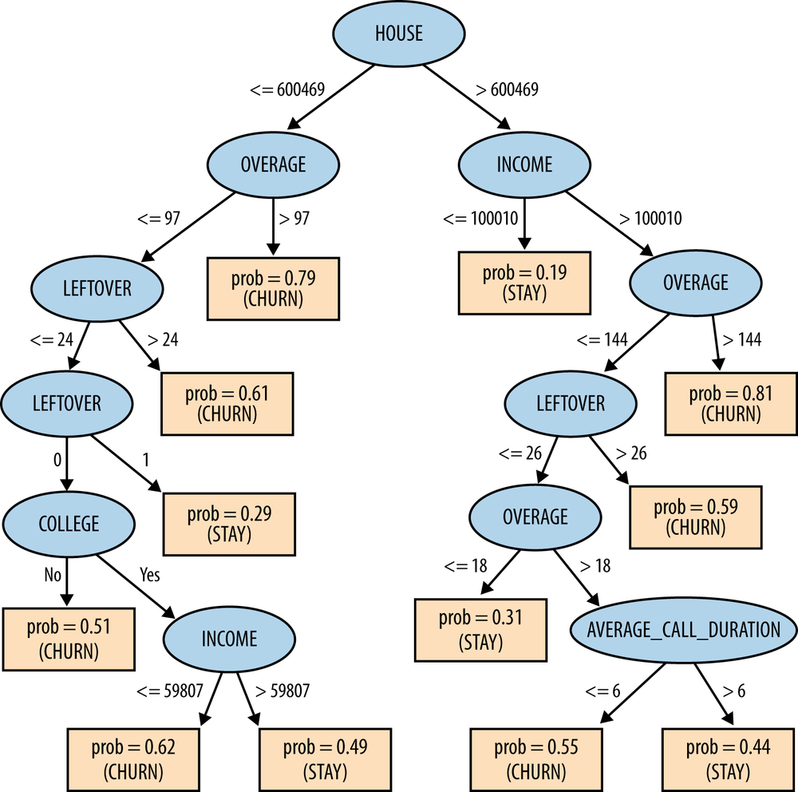
Churn Example
After building the model we find that we have 73% accuracy in identifying churn vs. stay.
Is this a good model?
Is it a reliable model?
Is it good enough?

